Slide 1
British Holidays: Customs and Traditions
made by teacher of English
Of Gymnasium № 17 of Nizhny Novgorod
Avramtseva Oksana Victorovna

Slide 2
Some British customs and traditions are famous all over the world. Bowler hats, tea and talking about the weather, for example. But what about the others?

Slide 3
From Scotland to Cornwall, Britain is full of customs and traditions. A lot of them have very long histories. Some are funny and some are strange. But they're all interesting. They are all part of the British way of life.

Slide 4
So many countries so many customs, an English proverb says. The British have many traditions, manners & customs of which they can be proud.

Slide 5
JANUARY
Up-HeIIy-Aa
The Shetlands are islands near Scotland. In the ninth centurv, men from Norway came to the Shetlands. These were the Vikings. They came to Britain in ships and carried away animals, gold, and sometimes women and children, too.
Now, 1 ,OOO years later, people in the Shetlands remember the Vikings with a festival. They call the festival "Up-Helly-Aa".
Every winter the people of Lerwick, a town in the Shetlands, make a model of a ship. It's a Viking "long-ship", with the head of a dragon at the front. Then, on Up-Helly-Aa night in January, the Shetlanders dress in Viking clothes. They carry the ship through the town to the sea. There they burn it. They do this because the Vikings put their dead men in ships and burned them. But there aren't any men in the modern ships. Now the festival is a party for the people of the Shetland Islands.

Slide 6
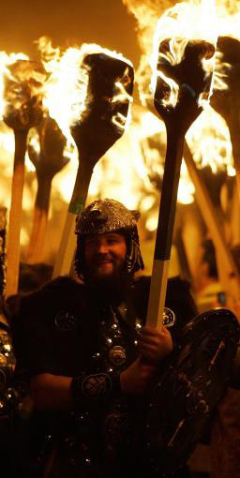

Slide 7
FEBRUARY
St Valentine's Day
St Valentine is the saint of people in love, and St Valentine's Day is February 14th. On that day, people send Valentine cards and presents to their husbands, wives, boyfriends and girlfriends. You can also send a card to a person you don't know. But traditionally you must never write your name on it. Some British newspapers have a page for Valentine's Day messages on Februarv 14th.

Slide 8
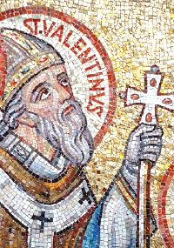
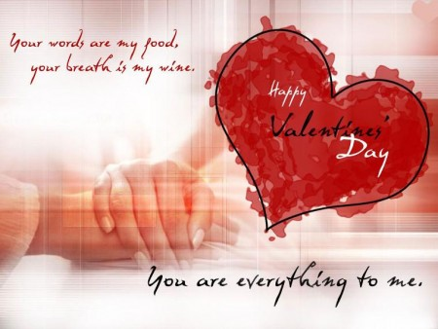

Slide 9
MARCH
St David's Day
March 1st is a very important day for Welsh people. It's St David's Day. He's the "patron" or national saint of Wales.
On March 1st, the Welsh celebrate St David's Day and wear daffodils in the buttonholes of their coats or jackets.

Slide 10
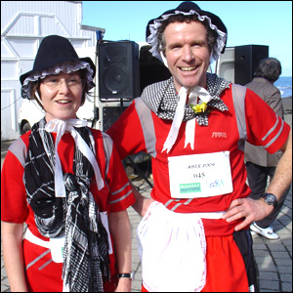
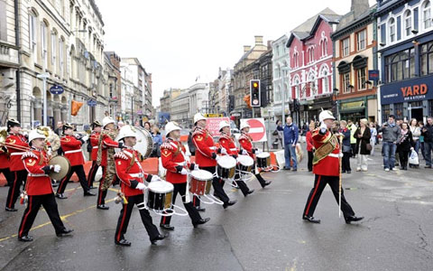

Slide 11
APRIL
April Fool's Day
April 1st is April Fool's Day in Britain. This is a very old tradition from the Middle Ages (between the fifth and fifteenth centuries). At that time the servants were masters for one day of the year. They gave orders to their masters, and their masters had to obey.
Now April Fool's Day is different. It's a day for jokes and tricks.

Slide 12
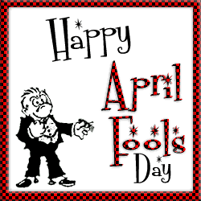
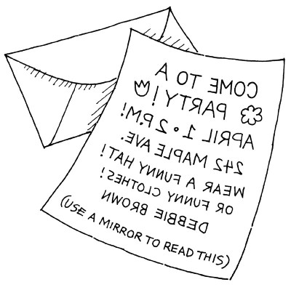

Slide 13
MAY
May Day
May 1st was an important day in the Middle Ages. In the very early morning, young girls went to the fields and washed their faces with dew. They believed this made them very beautiful for a year after that. Also on May Day the young men of each village tried to win prizes with their bows and arrows, and people danced round the maypole.
Many English-villages still have a maypole, and on May 1st, the villagers dance round it.

Slide 14
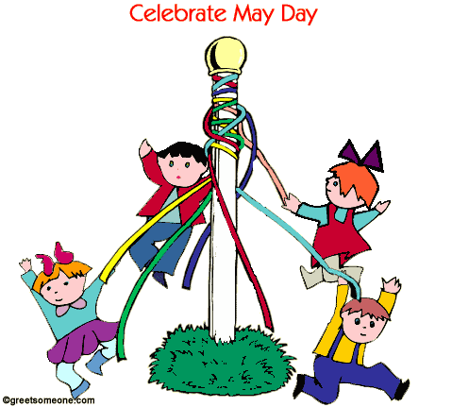
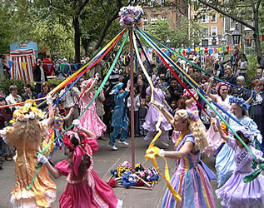

Slide 15
JUNE
Midsummer's Day
Midsummer's Day, June 24th, is the longest day of the year. On that day you can see a very old custom at Stonehenge, in Wiltshire, England. Stonehenge is one of Europe's biggest stone circles. A lot of the stones are ten or twelve metres high. It's also very old. The earliest part of Stonehenge is nearly 5,000 years old.
But what was Stonehenge? A holy place? A market? Or was it a kind of calendar? We think the Druids used it for a calendar. The Druids were the priests in Britain 2,000 years ago. They used the sun and the stones at Stonehenge to know the start of months and seasons. There are Druids in Britain today, too. And every June 24th a lot of them go to Stonehenge. On that morning the sun shines on one famous stone - the Heel stone. For the Druids this is a very important moment in the year. But for a lot of British people it's just a strange old custom.

Slide 16
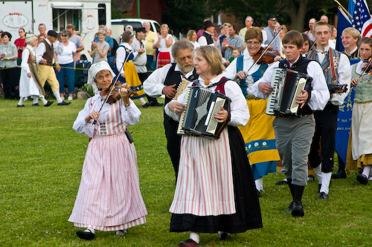
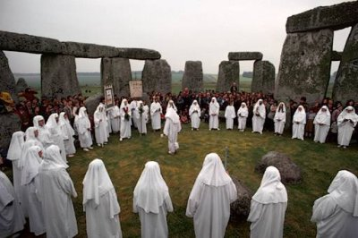

Slide 17
OCTOBER
Halloween
October 31st is Halloween, and you can expect to meet witches and ghosts that night. Halloween is an old word for "Hallows Evening", the night before "All Hallows" or "All Saints' Day"
On that one night of the year, ghosts and witches are free. Well, that's the traditional story. A long time ago people were afraid and stayed at home on Halloween. But now in Britain its a time for fun. There are always a lot of parties on October 31st. At these parties people wear masks and they dress as ghosts and witches, or as Dracula or Frankenstein's monster. And some people make special Halloween lamps from a large fruit, the pumpkin.
First they take out the middle of the pumpkin. Then they cut holes for the eyes, nose and mouth. Finally they put a candle inside the pumpkin.

Slide 18
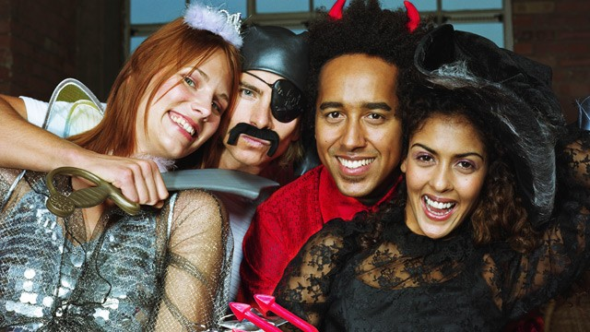
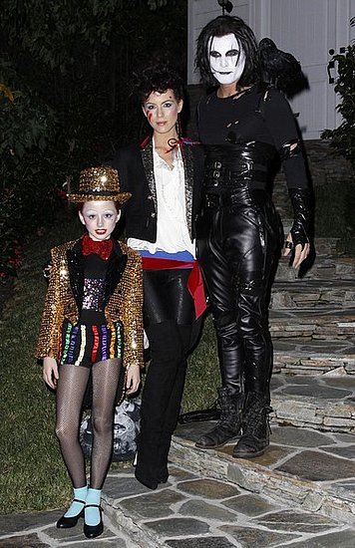
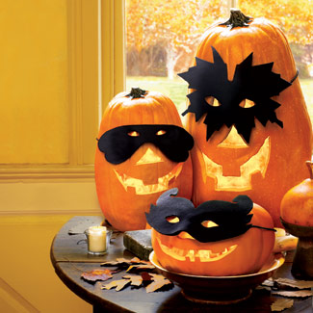

Slide 19
NOVEMBER
Guy Fawkes' Day
November 5th is Guy Faw kes’ Day in Britain. All over the country people build wood fires or “bonfires”, in their gardens. On top of each bonfire is a guy. That's a figure of Guy Fawkes. People make guys with straw, old clothes and newspapers. But before November 5th, children use their guys to make money They stand in the street and shout "Penny for the guy". Then they spend the money on fireworks. But how did this tradition start? Who was Guy Fawkes and why do the British remember him on November 5th?
On November 5th 1605, Guy Fawkes tried to kill King James I. He and a group of friends put a bomb under the Houses of Parliament in London. But the King's men found the bomb and they found Guy Fawkes, too. They took him to the Tower of London and there the King's men cut off his head.

Slide 20
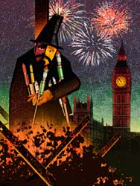

Slide 21
DECEMBER
Christmas and the New Year
There are lots of Christmas and New Year traditions in Britain.
For example...
London's Ghristmas decorations Every year the people of Norway give the city of London a present.. It's a big Christmas tree and it stands in Trafalgar Square.
Traditionally people decorate their trees on Christmas Eve - that's December 24th. They take down the decorations twelve days later, on Twelfth Night (January 5th). An older tradition is Christmas mistletoe. People put a piece of this green plant with its white berries over a door. Mistletoe brings good luck, people say. Also, at Christmas British people kiss their friends and family under the mistletoe.
Carols
Before Christmas, groups of singers go from house to house. They collect money and sing traditional Christmas songs or carols. There are a lot of very popular British Christmas carols. Three famous ones are:
"Good King Wenceslas", "The Holly and The Ivy" and "We Three Kings".

Slide 22
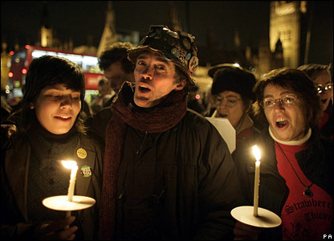
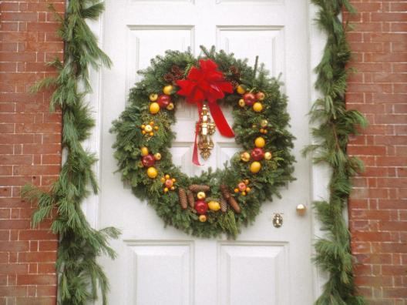
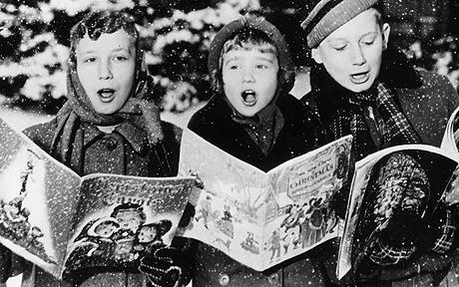

Slide 23
Boxing Day
December 26th is Boxing Day. Traditionally boys from the shops in each town asked for money at Christmas. They went from house to house on December 26th and took boxes made of wood with them. At each house people gave them money. This was a Christmas present. So the name of December 26th doesn't come from the sport of boxing - it comes from the boys' wooden boxes. Now, Boxing Day is an extra holiday after Christmas Day.

Slide 24
